Slide 1
Software Processes软件过程

Slide 2
Objectives
To introduce software process models
To describe three generic process models and when they may be used
To describe outline process models for requirements engineering, software development, testing and evolution
To explain the Rational Unified Process model
To introduce CASE technology to support software process activities
介绍软件过程模型
描述三个通用的流程模型和 他们何时使用
来描述需求工程,软件开发,测试和进化 的 概要过程模型
解释合理 的 统一过程模型
介绍 计算机辅助软件工程 技术，来支持软件过程的活动

Slide 3
Topics covered
Software process models
Process iteration
Process activities
The Rational Unified Process
Computer-aided software engineering
软件过程模型
迭代过程
流程活动
合理的 统一过程
计算机辅助软件工程CASE

Slide 4
The software process
A structured set of activities required to develop a software system
  Specification;
  Design;
  Validation;
  Evolution.
A software process model is an abstract representation of a process. It presents a description of a process from some particular perspective.
需要一套结构化的活动开发一个软件系统
  规范;
  设计;
  验证;
  进化。
软件过程模型是过程的一个抽象表现。它提出了一个从一些特定的角度的过程描述。

Slide 5
Generic software process models
通用软件过程模型
The waterfall model
  Separate and distinct phases of specification and development.
Evolutionary development
  Specification, development and validation are interleaved.
Component-based software engineering
  The system is assembled from existing components.
There are many variants of these models e.g. formal development where a waterfall-like process is used but the specification is a formal specification that is refined through several stages to an implementable design.
瀑布模型
  单独和不同阶段的 规范和开发。
进化开发
  规范、开发和验证是交错的。
基于组件的软件工程
  从现有的组件来组装系统。
这些模型有许多变体，如正式的开发惯用瀑布过程,但该规范是一个正式规范,细化了从几个阶段直到一个可实现的设计。

Slide 6
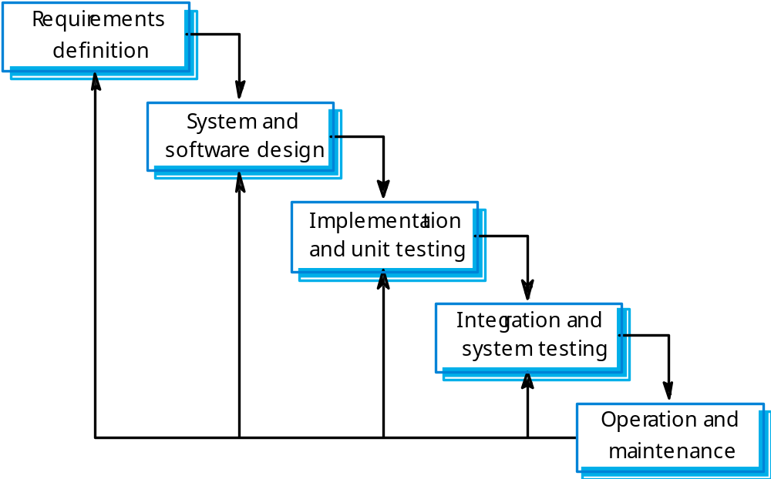
Waterfall model

Slide 7
Waterfall model phases瀑布模型阶段
Requirements analysis and definition
System and software design
Implementation and unit testing
Integration and system testing
Operation and maintenance
The main drawback of the waterfall model is the difficulty of accommodating change after the process is underway. One phase has to be complete before moving onto the next phase.
  需求分析和定义
系统和软件设计
实现和单元测试
集成和系统测试
操作和维护
瀑布模型的主要缺点是waterfall model is the difficulty of accommodating change after the process is underway。前一个阶段必须完成才能移动到下一个阶段。

Slide 8
Waterfall model problems瀑布模型问题
Inflexible partitioning of the project into distinct stages makes it difficult to respond to changing customer requirements.
Therefore, this model is only appropriate when the requirements are well-understood and changes will be fairly limited during the design process.
Few business systems have stable requirements.
The waterfall model is mostly used for large systems engineering projects where a system is developed at several sites.
项目僵化地划分成不同的阶段，使应对不断变化的客户需求很难。
因此,该模型是唯一适用于,在设计过程中的需求被很好理解和改变相当有限的时候。
  业务系统很少是有稳定的需求。
瀑布模型主要用于大型系统工程项目,一个系统在几个地点开发。

Slide 9
Evolutionary development进化开发
Exploratory development
  Objective is to work with customers and to evolve a final system from an initial outline specification. Should start with well-understood requirements and add new features as proposed by the customer.
Throw-away prototyping
  Objective is to understand the system requirements. Should start with poorly understood requirements to clarify what is really needed.
  探索开发
  目标是与客户合作，从最初的轮廓规范 发展最终的系统。应该从很好理解了的需求开始，然后增加客户所建议的新功能。
  废弃的原型
  目的是了解系统需求。应从了解甚少的需求开始，弄清什么是真正需要的。

Slide 10
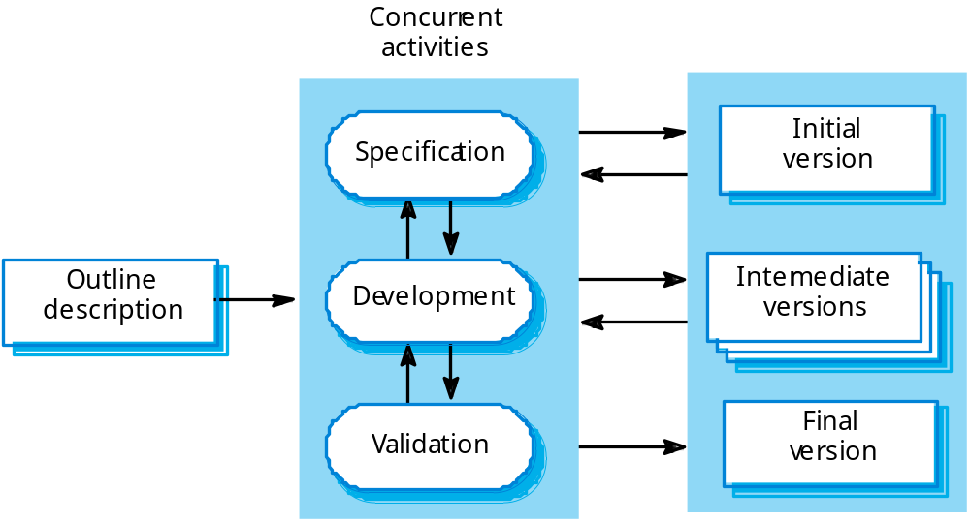
Evolutionary development

Slide 11
Evolutionary development
Problems
  Lack of process visibility;
  Systems are often poorly structured;
  Special skills (e.g. in languages for rapid prototyping) may be required.
Applicability
  For small or medium-size interactive systems;
  For parts of large systems (e.g. the user interface);
  For short-lifetime systems.
  问题
    缺乏过程的可见性;
    系统往往结构不佳的;
    特殊技能（例如，快速原型需要的语言）可能是必需的。
  适用性
    对于小型或中型交互系统;
    对于大型系统的部件（例如，用户接口）;
    对于短生命周期的系统。

Slide 12
Component-based software engineering
基于组件的软件工程
Based on systematic reuse where systems are integrated from existing components or COTS (Commercial-off-the-shelf) systems.
Process stages
  Component analysis;
  Requirements modification;
  System design with reuse;
  Development and integration.
This approach is becoming increasingly used as component standards have emerged.
基于系统化复用，系统由现有组件或 COTS（商业现货系统）的集成。
流程阶段
  组件分析;
  需求修改;
  系统设计与重用;
  开发和集成。
这种做法 is becoming increasingly used as component standards have emerged.

Slide 13
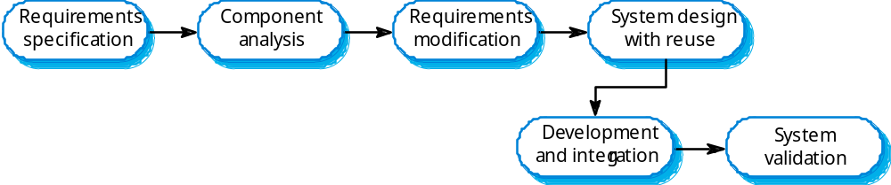
Reuse-oriented development
面向复用的开发

Slide 14
Process iteration过程迭代
System requirements ALWAYS evolve in the course of a project so process iteration where earlier stages are reworked is always part of the process for large systems.
Iteration can be applied to any of the generic process models.
Two (related) approaches
  Incremental delivery;
  Spiral development.
  系统需求总是在项目发展过程中形成, 过程迭代，初期阶段做重复工作，一直是大型系统的过程的一部分。
  迭代可以应用于任何通用的过程模型。
  两个(相关的)的方法
    增量 Incremental 交付;
    螺旋型开发。

Slide 15
Incremental delivery增量交付
Rather than deliver the system as a single delivery, the development and delivery is broken down into increments with each increment delivering part of the required functionality.
User requirements are prioritised and the highest priority requirements are included in early increments.
Once the development of an increment is started, the requirements are frozen though requirements for later increments can continue to evolve
交付系统不是作为一个单独的交付, the development and delivery is broken down into increments with each increment delivering part of the required functionality.
用户需求优先和最高优先级需求都包含在早期的增量。
一旦开始增量的开发,需求被冻结，尽管后来要求的增量可以继续发展。

Slide 16
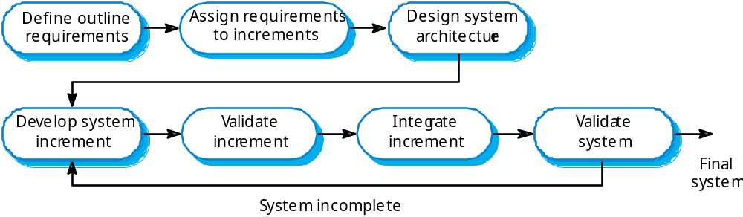
Incremental development
Outline 总体的 assign 分配 validate 验证

Slide 17
Incremental development advantages
增量开发的优势
Customer value can be delivered with each increment so system functionality is available earlier.
Early increments act as a prototype to help elicit requirements for later increments.
Lower risk of overall project failure.
The highest priority system services tend to receive the most testing.
随着每个增量，客户的意思可以得到理解，系统功能更早地可用。
早期的增量作为原型 来帮助引出后来增加的需求。
降低整体项目失败的风险。
  最高优先级系统服务 得到的最多的测试。

Slide 18
Extreme programming极限编程
An approach to development based on the development and delivery of very small increments of functionality.
Relies on constant code improvement, user involvement in the development team and pairwise programming.
Covered in Chapter 17
一个 基于很小的功能增量 来开发和交付的方法。
依赖于不断改进代码,用户参与开发团队和成对地编程。
在第十七章

Slide 19
Spiral development螺旋发展
Process is represented as a spiral rather than as a sequence of activities with backtracking.
Each loop in the spiral represents a phase in the process.
No fixed phases such as specification or design - loops in the spiral are chosen depending on what is required.
Risks are explicitly assessed and resolved throughout the process.
  过程表示为螺旋而不是与回溯的活动序列。
螺旋代表一个阶段中的每一个循环过程。
没有固定的规范或设计等阶段,在螺旋中循环的选择 取决于什么是所需的。
在这个过程中 风险得到明确评估和解决。

Slide 20
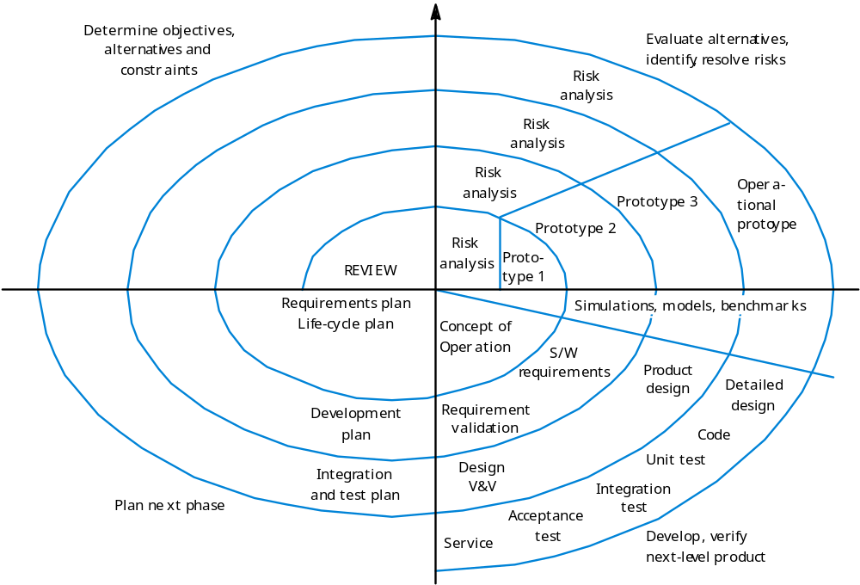
Spiral model of the software process

Slide 21
Spiral model sectors螺旋模型领域
Objective setting
  Specific objectives for the phase are identified.
Risk assessment and reduction
  Risks are assessed and activities put in place to reduce the key risks.
Development and validation
  A development model for the system is chosen which can be any of the generic models.
Planning
  The project is reviewed and the next phase of the spiral is planned.
  目标设置
  确定具体目标的阶段。
  风险评估和减少
  风险评估和活动,来降低风险的关键。
  开发和验证
  系统选择的发展模式可以是任何的通用模型。
  规划
  项目回顾 和 计划的下一阶段的螺旋。

Slide 22
Process activities流程活动
Software specification
Software design and implementation
Software validation
Software evolution
软件规范
软件设计和实现
软件验证
软件进化evolution

Slide 23
Software specification软件规范
The process of establishing what services are required and the constraints on the system’s operation and development.
Requirements engineering process
  Feasibility study;
  Requirements elicitation and analysis;
  Requirements specification;
  Requirements validation.
  建立一个过程 系统的运作和发展需要哪些服务和约束。
  需求工程过程
    可行性研究;
    需求获取和分析;
    需求规范;
    需求验证。

Slide 24
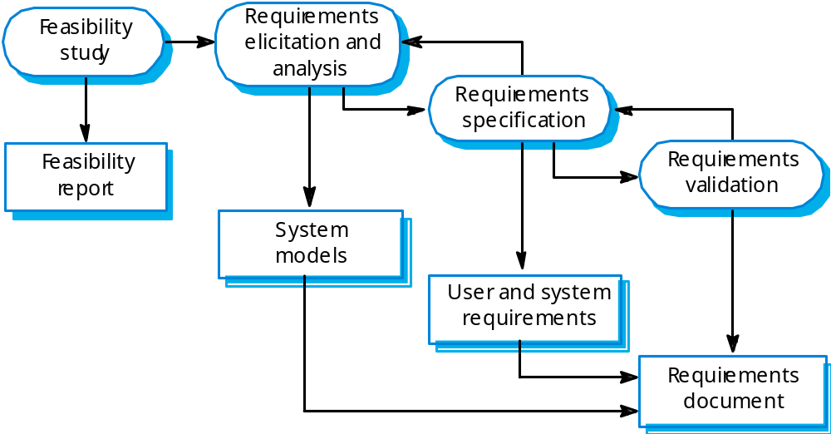
The requirements engineering process
需求工程过程

Slide 25
Software design and implementation
软件设计与实现
The process of converting the system specification into an executable system.
Software design
  Design a software structure that realises the specification;
Implementation
  Translate this structure into an executable program;
The activities of design and implementation are closely related and may be inter-leaved.
,将系统规范转化为一个可执行的系统 的过程 。
软件设计
  设计软件结构,识别了规范;
实现
  将软件设计的结构转化为一个可执行程序;
设计和实现的活动,可能 Inter-leaved 密切相关。

Slide 26
Design process activities
设计过程的活动
Architectural design
Abstract specification
Interface design
Component design
Data structure design
Algorithm design
体系结构设计
抽象的规范
接口设计
组件设计
数据结构设计
算法设计

Slide 27
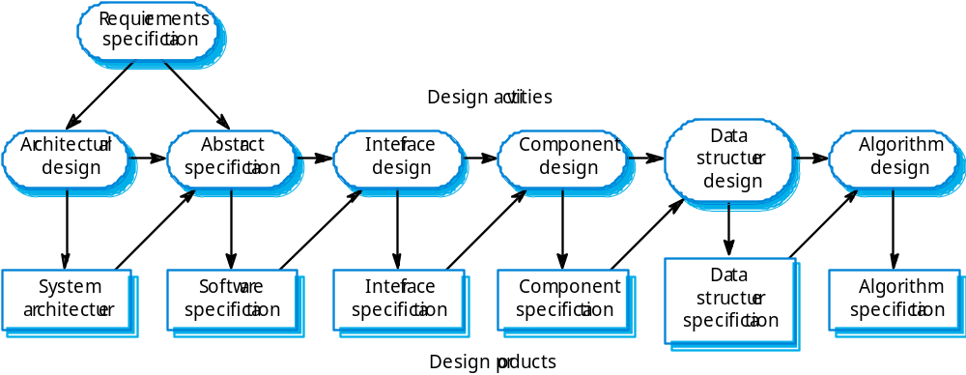
The software design process
软件设计过程

Slide 28
Structured methods结构化方法
Systematic approaches to developing a software design.
The design is usually documented as a set of graphical models.
Possible models
  Object model;
  Sequence model;
  State transition model;
  Structural model;
  Data-flow model.
  系统的方法来改进一个软件设计。
  设计通常是用一组图形模型 来记录。
  可能的模型
    对象模型;
    序列模型;
    状态转换模型;
    结构模型;
    数据流模型。

Slide 29
Programming and debugging
编程和调试
Translating a design into a program and removing errors from that program.
Programming is a personal activity - there is no generic programming process.
Programmers carry out some program testing to discover faults in the program and remove these faults in the debugging process.
将设计转化为一个程序，并从程序中删除错误。
编程是一种个人活动——没有通用的编程过程。
程序员进行一些测试来发现程序中的错误,调试过程移除这些错误。

Slide 30
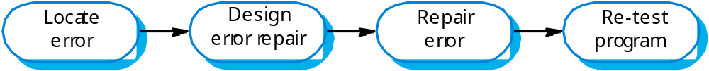
The debugging process调试过程

Slide 31
Software validation软件确认
Verification and validation (V & V) is intended to show that a system conforms to its specification and meets the requirements of the system customer.
Involves checking and review processes and system testing.
System testing involves executing the system with test cases that are derived from the specification of the real data to be processed by the system.
验证和确认(V & V)旨在表明系统符合规范,系统满足客户需求的。
包括检查和审查流程和系统测试。
系统测试包括执行系统测试用例，这些用例是由系统规范要处理的真正的数据。

Slide 32
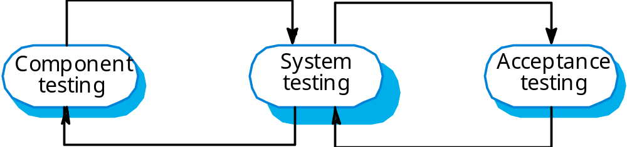
The testing process测试过程
Acceptance 验收

Slide 33
Testing stages测试阶段
Component or unit testing
  Individual components are tested independently;
  Components may be functions or objects or coherent groupings of these entities.
System testing
  Testing of the system as a whole. Testing of emergent properties is particularly important.
Acceptance testing
  Testing with customer data to check that the system meets the customer’s needs.
  组件或单元测试
  单个组件是独立测试;
  组件可能是函数或对象或这些实体的相干集合。
  系统测试
  测试的系统作为一个整体。测试的涌现性尤为重要。
  验收测试
  测试与客户数据检查系统是否满足客户的需求。

Slide 34
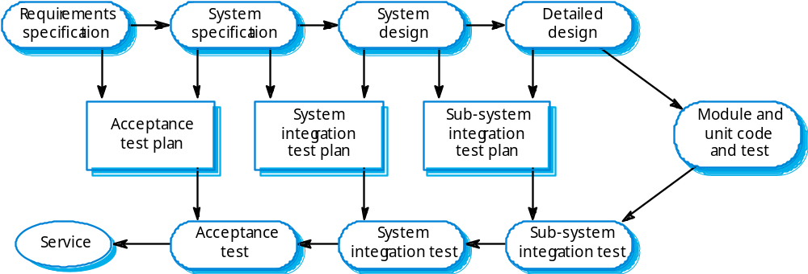
Testing phases

Slide 35
Software evolution软件进化
Software is inherently flexible and can change.
As requirements change through changing business circumstances, the software that supports the business must also evolve and change.
Although there has been a demarcation between development and evolution (maintenance) this is increasingly irrelevant as fewer and fewer systems are completely new.
软件本身是灵活和可以改变的。
当业务变化的情况下需求也发生着变化,软件支持业务也必须发展和变化。
虽然已经有了发展与进化之间的界定(维护) 但这是无关紧要的,因为越来越少的系统是全新的。

Slide 36
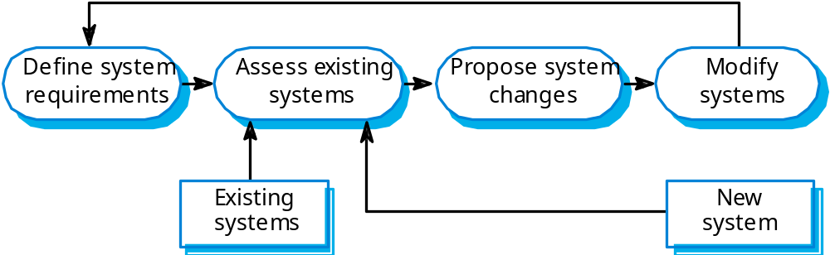
System evolution
Assess 评估 propose 提出 modify 修改

Slide 37
The Rational Unified Process
统一软件开发过程RUP
A modern process model derived from the work on the UML and associated process.
Normally described from 3 perspectives
  A dynamic perspective that shows phases over time;
  A static perspective that shows process activities;
  A practive perspective that suggests good practice.
  UML工作驱动的现代流程模型和相关流程。
  通常从3个角度进行描述
    动态的角度 显示各时间阶段;
    静态的角度 显示过程活动;
    耗量的角度 表明良好实践。

Slide 38
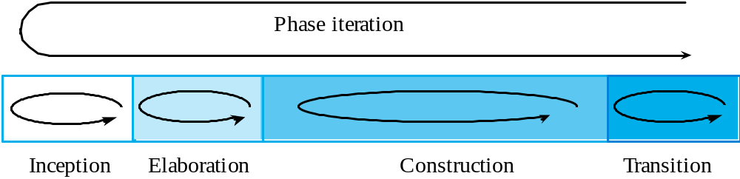
RUP phase model_RUP阶段模型
Inception 最初 elaboration 细化 construction建设 transition 过渡

Slide 39
RUP phases
Inception
  Establish the business case for the system.
Elaboration
  Develop an understanding of the problem domain and the system architecture.
Construction
  System design, programming and testing.
Transition
  Deploy the system in its operating environment.
  起初
  建立系统的业务案例。
  细化
  开发一个对问题域和系统架构的理解。
  建设
  系统设计、编程和测试。
  过渡
  部署系统的操作环境。

Slide 40
RUP good practice_RUP良好的实践
Develop software iteratively
Manage requirements
Use component-based architectures
Visually model software
Verify software quality
Control changes to software
迭代开发软件
管理需求
使用 基于组件 的体系结构
视觉模型的软件
验证软件质量
控制软件的改变

Slide 41
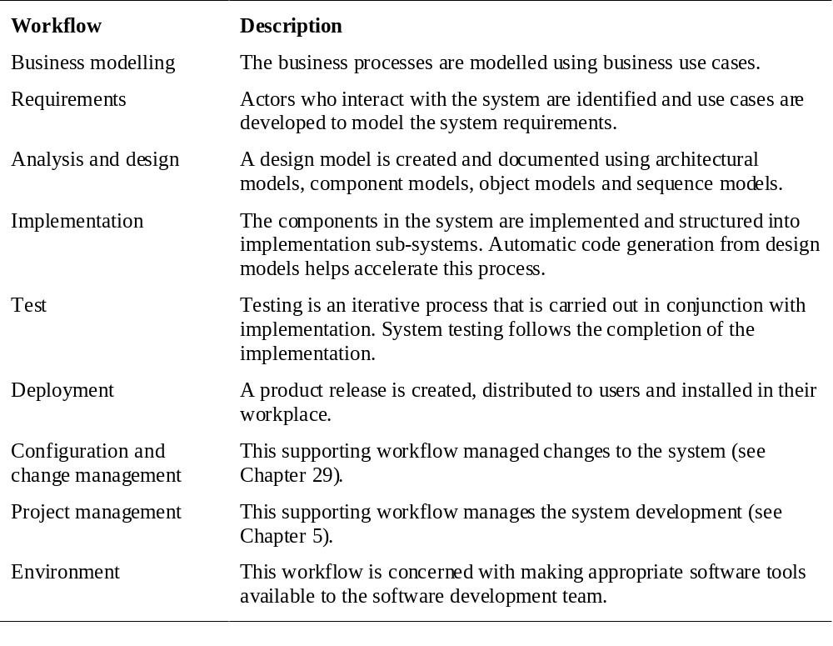
Static workflow静态工作流

Slide 42
Computer-aided software engineering
计算机辅助软件工程CASE
Computer-aided software engineering (CASE) is software to support software development and evolution processes.
Activity automation
  Graphical editors for system model development;
  Data dictionary to manage design entities;
  Graphical UI builder for user interface construction;
  Debuggers to support program fault finding;
  Automated translators to generate new versions of a program.
  计算机辅助软件工程(CASE)是支持软件开发和进化的过程软件。
  活动自动化Activity automation
  图形编辑器系统模型开发;
  数据字典管理设计实体;
  图形用户界面构建器的用户界面结构;
  调试器支持程序故障探测;
  自动翻译生成新版本的程序。

Slide 43
CASE technology
计算机辅助软件工程技术
Case technology has led to significant improvements in the software process. However, these are not the order of magnitude improvements that were once predicted
  Software engineering requires creative thought - this is not readily automated;
  Software engineering is a team activity and, for large projects, much time is spent in team interactions. CASE technology does not really support these.
  计算机辅助软件工程技术导致了软件过程的重大改进。然而,这些都不是曾经预测的数量级的改进
  1软件工程需要创造性思维——这不是容易自动化;
  2软件工程是一种团队活动,对于大型项目,很多时间是花在团队互动。计算机辅助软件工程技术并不支持这些。

Slide 44
CASE classification
计算机辅助软件工程分类
Classification helps us understand the different types of CASE tools and their support for process activities.
Functional perspective
  Tools are classified according to their specific function.
Process perspective
  Tools are classified according to process activities that are supported.
Integration perspective
  Tools are classified according to their organisation into integrated units.
  分类可以帮助我们理解不同类型的计算机辅助软件工程工具和他们对过程活动的支持。
  功能角度
  工具 根据 其特定的功能 进行分类。
  过程的角度
  工具 根据 流程活动支持 进行分类。
  集成的角度
  工具 根据 他们组织成一个完整的单位 分类。

Slide 45
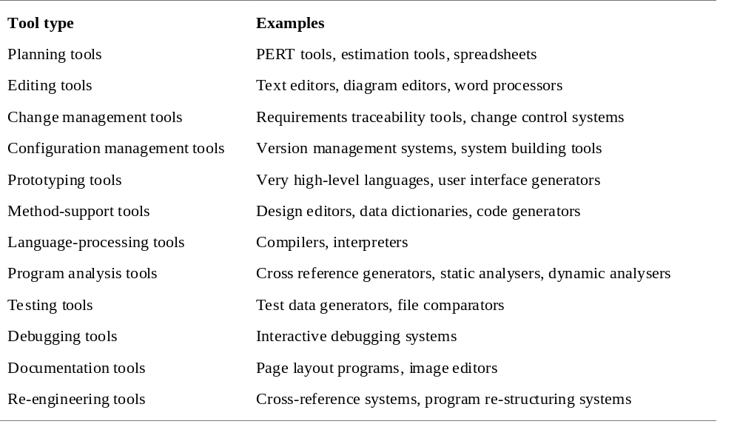
Functional tool classification
功能工具分类

Slide 46
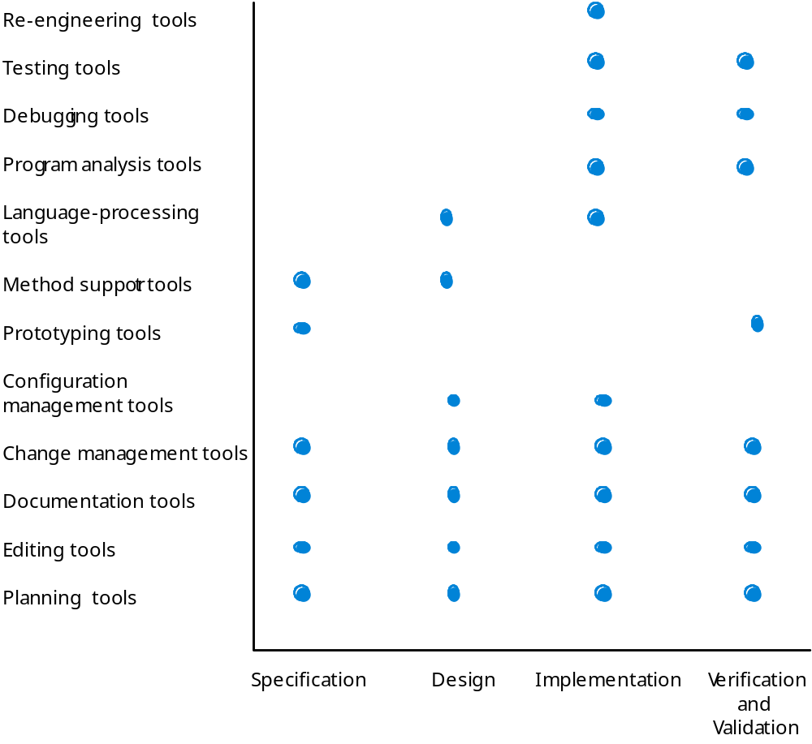
Activity-based tool classification基于活动的工具分类

Slide 47
CASE integration
计算机辅助软件工程集成
Tools
  Support individual process tasks such as design consistency checking, text editing, etc.
Workbenches
  Support a process phase such as specification or design, Normally include a number of integrated tools.
Environments
  Support all or a substantial part of an entire software process. Normally include several integrated workbenches.
  工具
  支持单个过程设计等任务的一致性检查,文本编辑等。
  工作台
  支持过程比如规范或设计阶段,通常包括一个集成的工具。
  环境
  支持所有或大部分的整个软件过程。通常包括几个综合工作台。

Slide 48
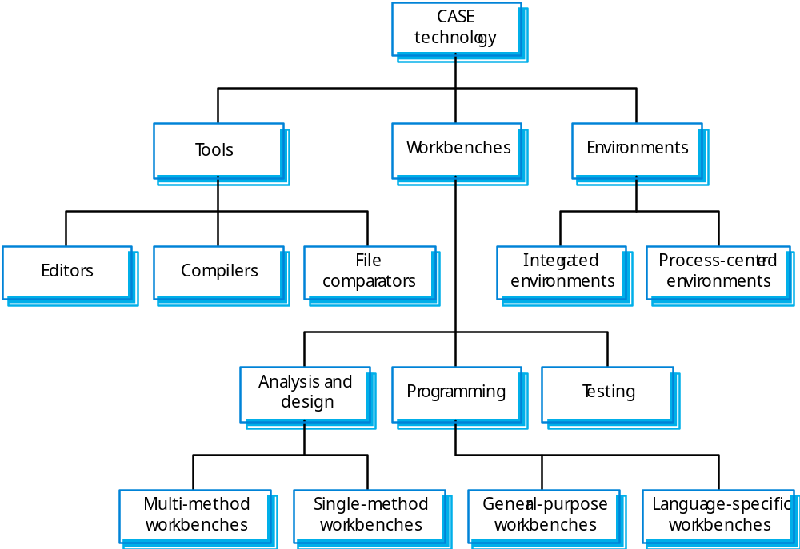
Tools, workbenches, environments
工具、工作台、环境

Slide 49
Key points
Software processes are the activities involved in producing and evolving a software system.
Software process models are abstract representations of these processes.
General activities are specification, design and implementation, validation and evolution.
Generic process models describe the organisation of software processes. Examples include the waterfall model, evolutionary development and component-based software engineering.
Iterative process models describe the software process as a cycle of activities.
软件过程 是 参与生产和发展的软件系统的活动。
软件过程模型是这些过程的抽象表示。
通常活动包括 规范、设计和实现、验证和进化。
软件过程的组织用通用流程模型描来述。包括瀑布模型、进化开发和基于组件的软件工程。
迭代过程模型描述the software process as a cycle of activities 。

Slide 50
Key points
Requirements engineering is the process of developing a software specification.
Design and implementation processes transform the specification to an executable program.
Validation involves checking that the system meets to its specification and user needs.
Evolution is concerned with modifying the system after it is in use.
The Rational Unified Process is a generic process model that separates activities from phases.
CASE technology supports software process activities.
需求工程。
设计和实现。
验证。
进化。
RUP统一软件开发过程。
CASE技术。

